Slide 1


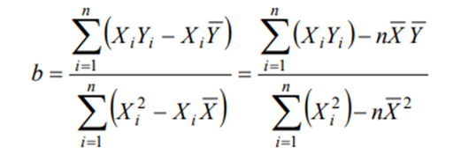
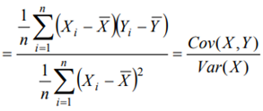


Slide 2
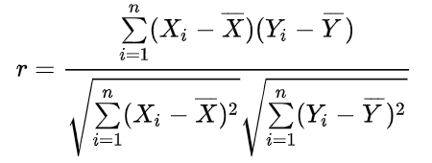


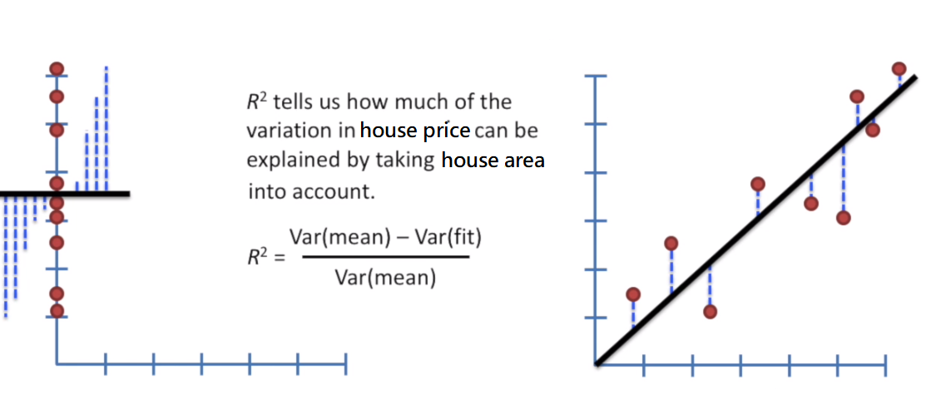
Correlations and Relationships
Correlation coefficient
Two variable x and y, correlation coefficient ( r ) is defined as

Slide 3


Slide 4
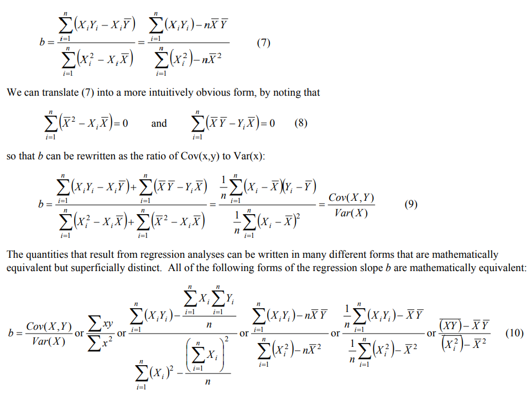

Slide 5
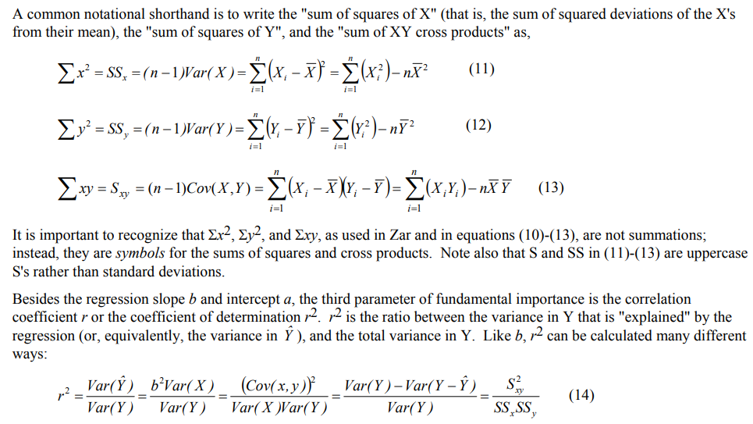
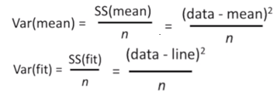


Slide 6

Logistic Regression
Why can’t we use Linear Regression to model binary responses?
→ Linear regression is the type of regression we use for a continuous, normally distributed response (Y) variable
The response (Y) is NOT normally distributed
The variability of Y is NOT constant
Variance of Y depends on the expected value of Y
For a Y~Binomial(n,p),
we have Var(Y)=np(1-p) which depends on the expected response, E(Y)=np
The model must produce predicted/fitted probabilities that are between 0 and 1
Linear models produce fitted responses that vary from -∞ to ∞

Slide 7
Logistic regression
Dependent variable is categorical variables (nominal or ordinal dependent variables)
For example: voting, morbidity or mortality, and participation data is not continuous or distributed normally.
Binary logistic regression is a type of regression analysis where the dependent variable is a dummy variable: coded 0 (did not vote) or 1(did vote); coded 0 (not sick) or 1(sick)
Dummy variable : 啞變量或虛擬變量是指迴歸模型中用數字來替代並表示定性事實，從而將數據分為互斥的類別(0或1)。

Slide 8
The Logistic Regression Model
Logistic Regression ( "logit" regression model) ln[p/(1-p)] = α + βX
p is the probability that the event Y occurs (success), p(Y=1)
1-p is the probability that the event Y does not occur(fail), p(Y=0)
p/(1-p) is the "odds"
ln[p/(1-p)] is the log odds, or "logit"

Slide 9
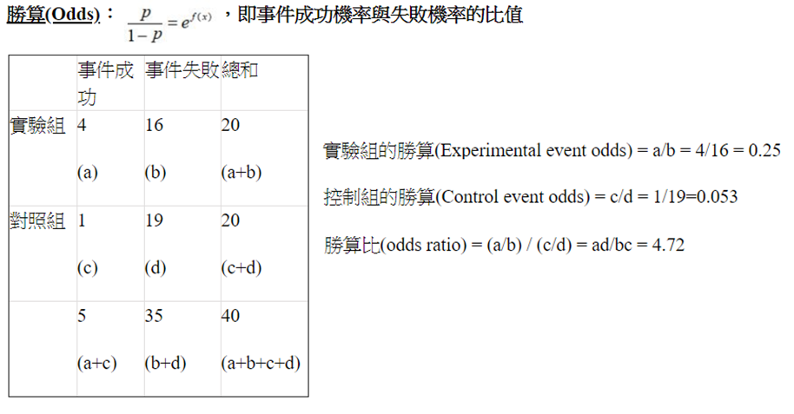

Slide 10
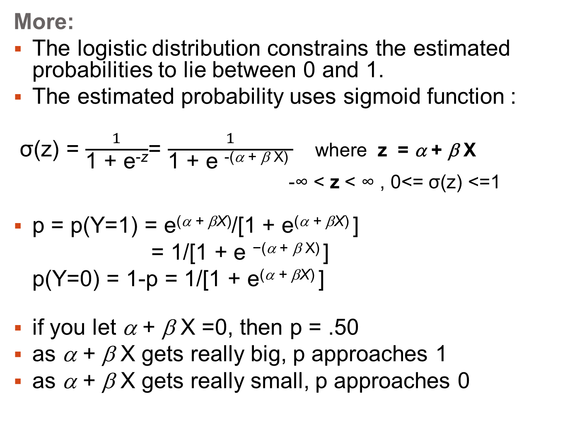
More:
The logistic distribution constrains the estimated probabilities to lie between 0 and 1.
The estimated probability uses sigmoid function :
σ(z) = $\frac{1}{\text{1 + }\text{e}\text{−}\text{z}}$= $\frac{1}{\text{1 + }\text{e} \text{−}\text{(}\text{α}\text{ + }\text{β} \text{X}\text{)} }$ where z = α + β X
-∞ < z < ∞ , 0<= σ(z) <=1
p = p(Y=1) = e^{(α + βX)}/[1 + e^{(α + βX)} ]
= 1/[1 + $\text{e}\text{ −(}\text{α}\text{ + }\text{β} \text{X}\text{)}$]
p(Y=0) = 1-p = 1/[1 + e^{(α + βX)} ]
if you let α + β X =0, then p = .50
as α + β X gets really big, p approaches 1
as α + β X gets really small, p approaches 0

Slide 11

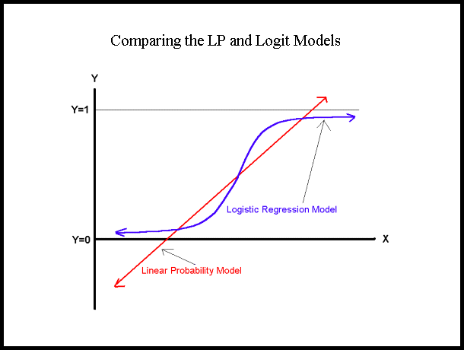
sigmoid function
Y= σ(x) = $\frac{1}{\text{1 + }\text{e}\text{−}\text{x}}$
Y = α + β X

Slide 12
An interpretation of the logit coefficient which is usually more intuitive is the "odds of the event"
Since: odds (勝算) [p/(1-p)] = e^{(α + βX)}
ln([p/(1-p)] = ln(e^{(α + βX)}) = α + βX
β increment implies the change of odds of event
→ using exp(β) instead of β to describe the effect of the independent variable on the "odds of event"

Slide 13
Multi-class Logistic Regression
We have already learned about logistic regression for binary logistic regression as the target variable (i.e. bought product) in customer income data has two classes 1 (bought product) and 0 (didn't buy product). Here, we will to discuss about multi - class logistic regression.
Multi - class Logistic Regression: Here the target variable has more than two possible classes/categories. For example, salary of an employee can be categorized as 'low', 'medium' and 'high'. There are two types of multi - class logistic regression:
Multinomial Logistic Regression: The target variable has three or more classes/categories which are not in any particular order. So, there are three or more nominal categories. Examples: Fruits (apple, mango, orange and banana), Profession (e.g., with five groups: surgeon, doctor, nurse, dentist, therapist)
Ordinal Logistic Regression: The target variable has three or more ordinal categories. So, there is intrinsic order involved with the categories. For example, the student performance can be categorized as poor, average, good and excellent, the salary of an employee can be categorized as 'low', 'medium' and 'high'

Slide 14
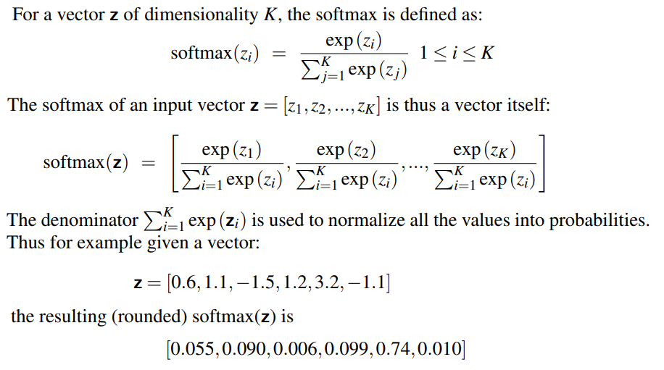
The multinomial logistic classifier uses a generalization of the sigmoid, called the softmax function

Slide 15
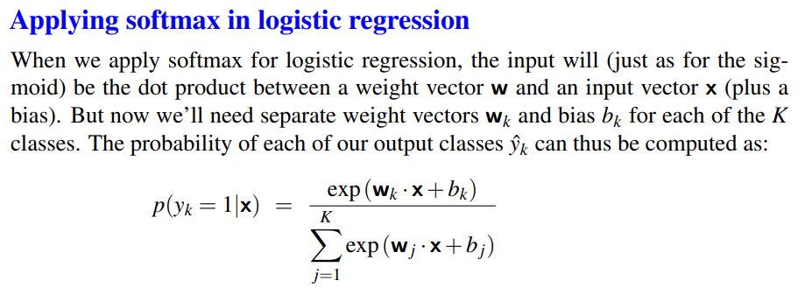
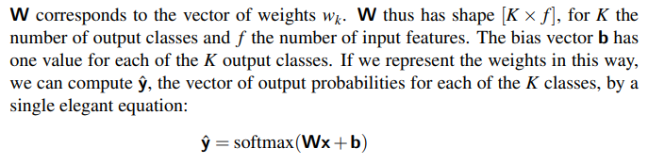

Slide 16
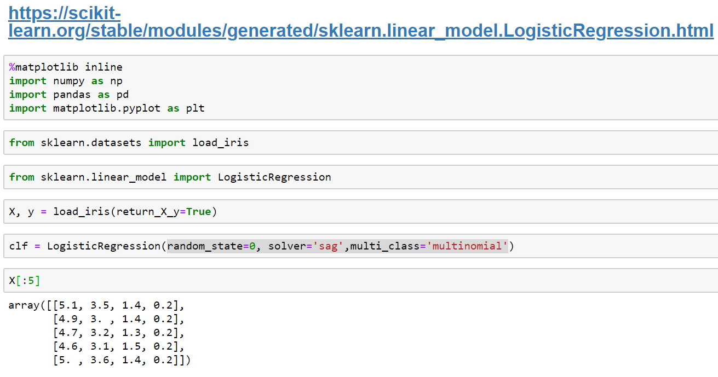
NOTE: The LogisticRegression class can be configured for multinomial logistic regression by setting the “multi_class” argument to “multinomial”.

Slide 17
